Slide 1
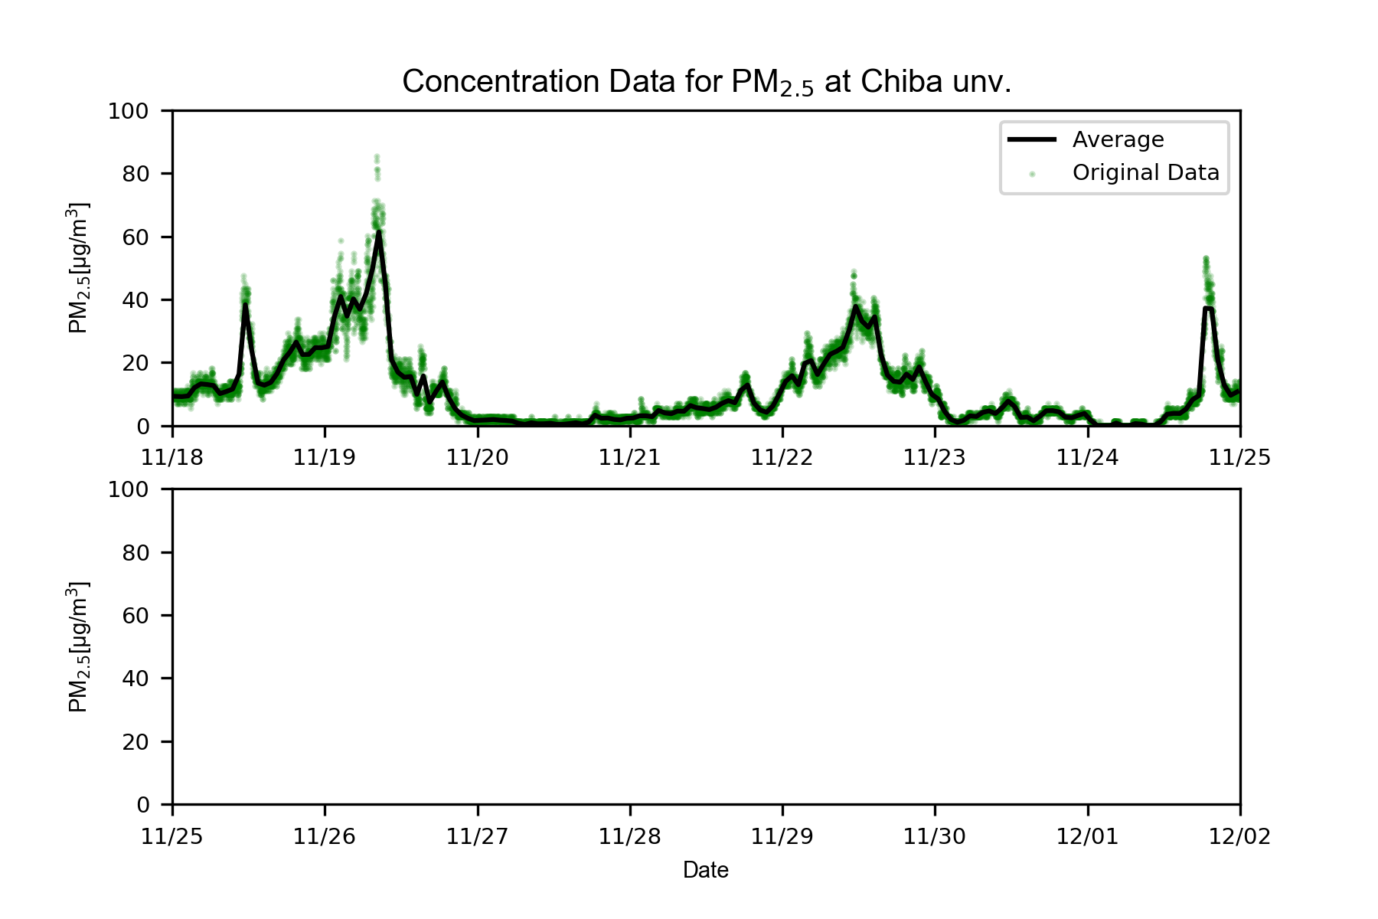
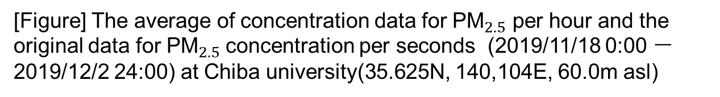
[Figure] The average of concentration data for ${\text{PM}}_{2.5}$ per hour and the original data for ${\text{PM}}_{2.5}$concentration per seconds (2019/11/18 0:00 ー 2019/12/2 24:00) at Chiba university(35.625N, 140,104E, 60.0m asl)

